Slide 1


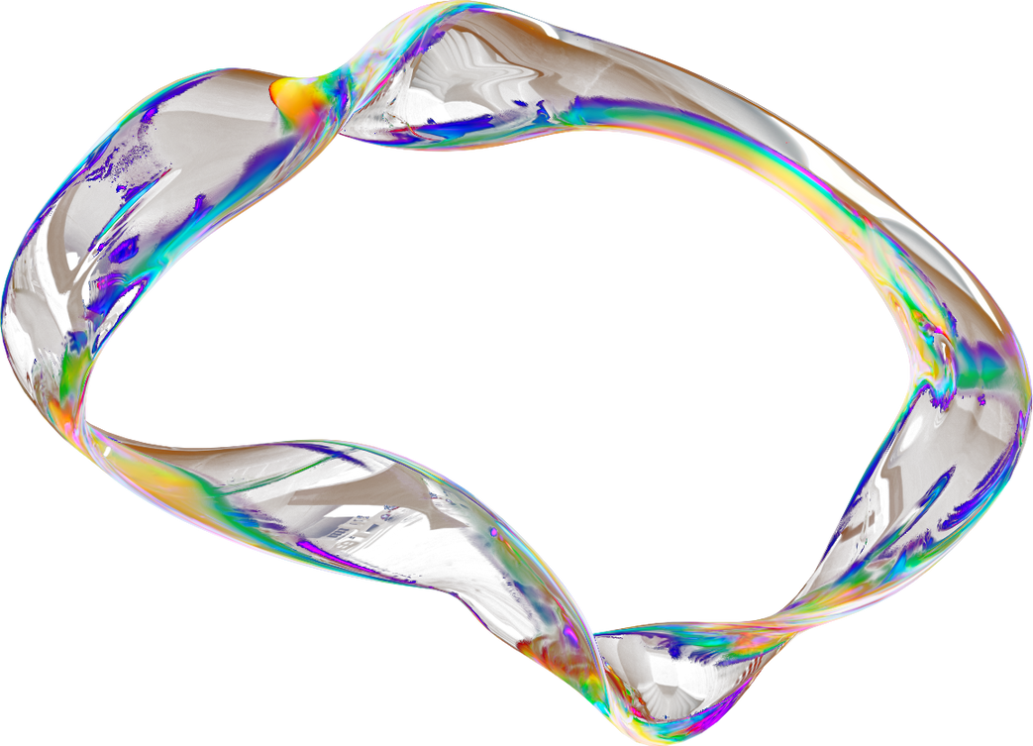

Fashion MNIST Clustering
Unsupervised Learning

Slide 2

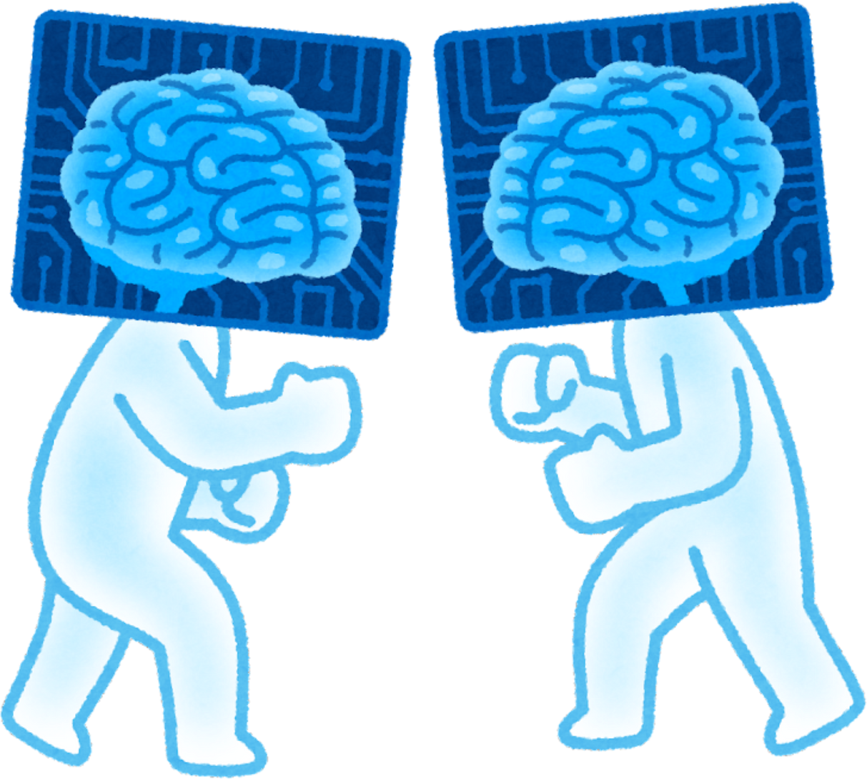
Objective:
Analyze the Fashion MNIST dataset using unsupervised learning techniques.
Determine the natural number of clusters in the data.
Identify which fashion items are most confused and why.
Assess if the model can auto-group new fashion items.

Slide 3


Dataset Overview:
70,000 grayscale images (28x28 pixels).
10 classes (T-shirt, Dress, Sneaker, etc.).

Slide 4


Key Takeaways
Number of Groups:
The best number is 10 groups (same as the real categories).
Some groups overlap (like T-shirts vs. Shirts).
Most Confused Items:
Shirts, T-shirts, Pullovers (they look similar).
Sneakers, Sandals, Boots (all footwear).
Can It Auto-Sort New Items?
Yes, but not perfectly. Works best for clear categories (like "Bags" vs. "Pants").
www.reallygreatsite.com

Slide 5

How Many Clusters Does the Data Naturally Form?
Evidence from Analysis:
Elbow Method (PCA/KMeans):
Inertia drops sharply up to k=10, then plateaus.
Silhouette Score:
Highest at k=10 (~0.25, though low due to overlapping classes).
True Labels in PCA Space:
10 visible but overlapping clusters.
Conclusion:
10 clusters align with true labels, but some overlap exists.

Slide 6
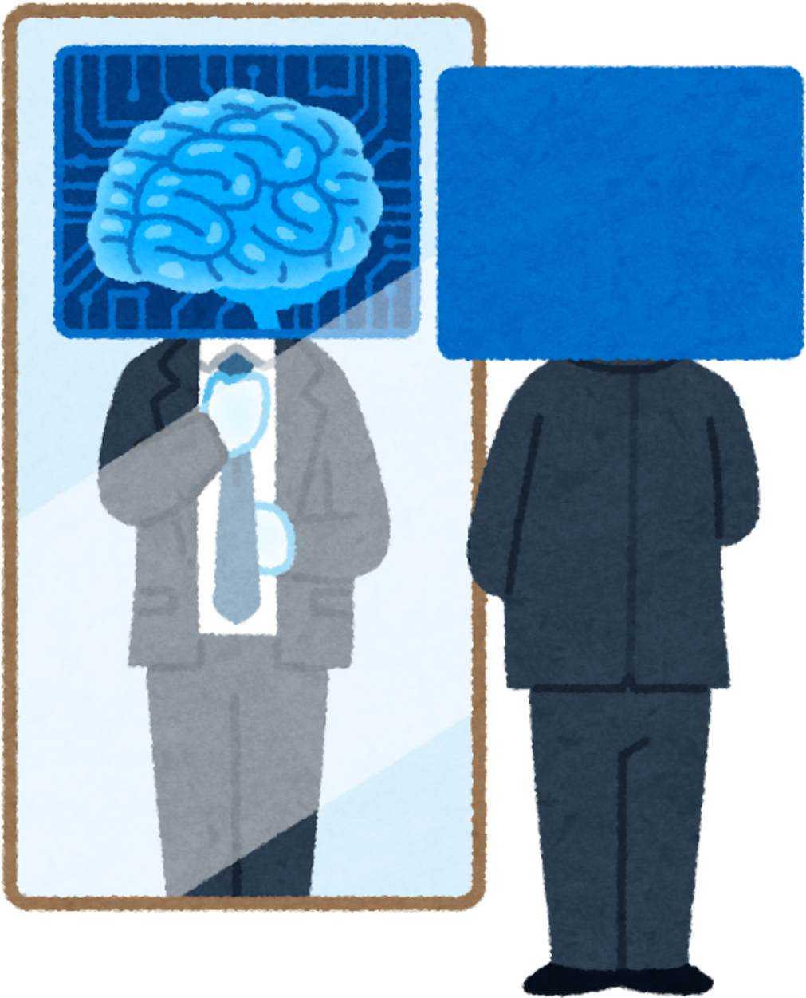

Which Items Are Most Confused? Why?
Confusion Matrix & Purity Table Insights:
High Confusion Pairs:
Shirts (6) vs. T-shirts (0) vs. Pullovers (2):
Similar silhouettes (loose-fitting tops).
Sneakers (7) vs. Sandals (5) vs. Ankle Boots (9):
Footwear with minor pixel differences.
Least Confused Items:
Trousers (1) and Bags (8):
Distinct shapes (straight lines vs. compact form).
Why?
Pixel patterns for some classes are too similar.

Slide 7


Can the System Auto-Group New Fashion Items?
Pros:
✅ Works well for distinct categories (e.g., Bags vs. Trousers).
✅ PCA/KMeans achieves ~0.4–0.5 NMI, suggesting moderate grouping accuracy.
Limitations:
❌ Fails for fine-grained distinctions (e.g., Shirts vs. T-shirts).
❌ DBSCAN struggles (noise points, inconsistent clusters).

Slide 8
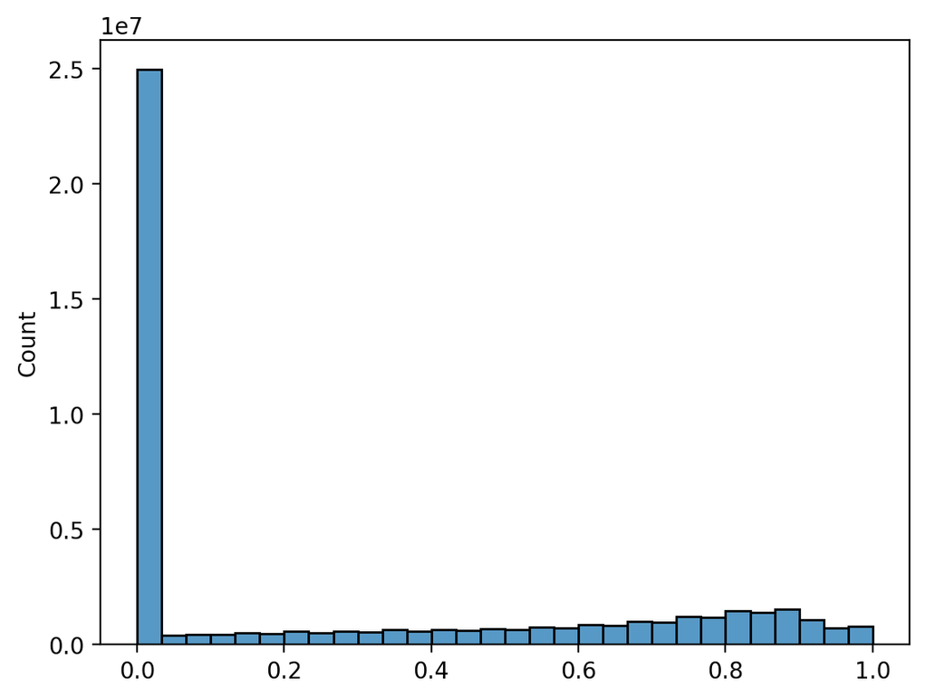
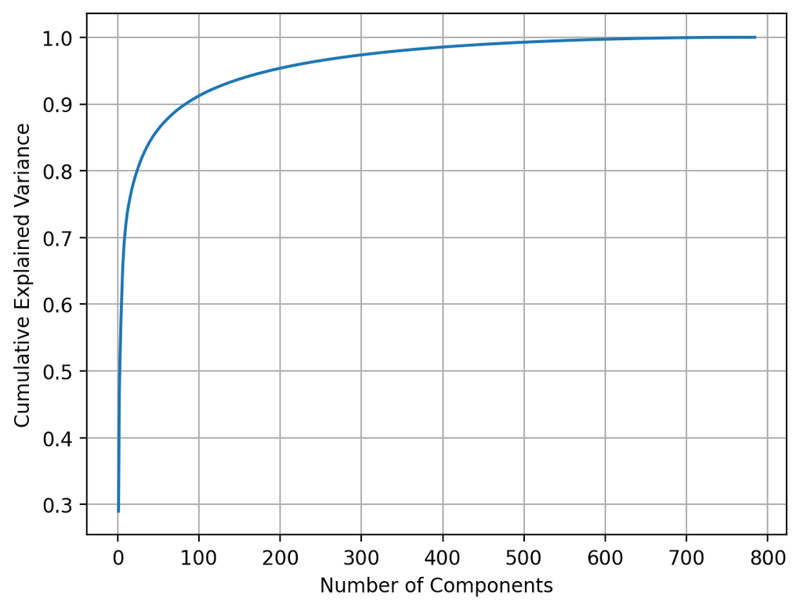
Visualization Highlights
Pixel Value Distribution
Explained Variance

Slide 9
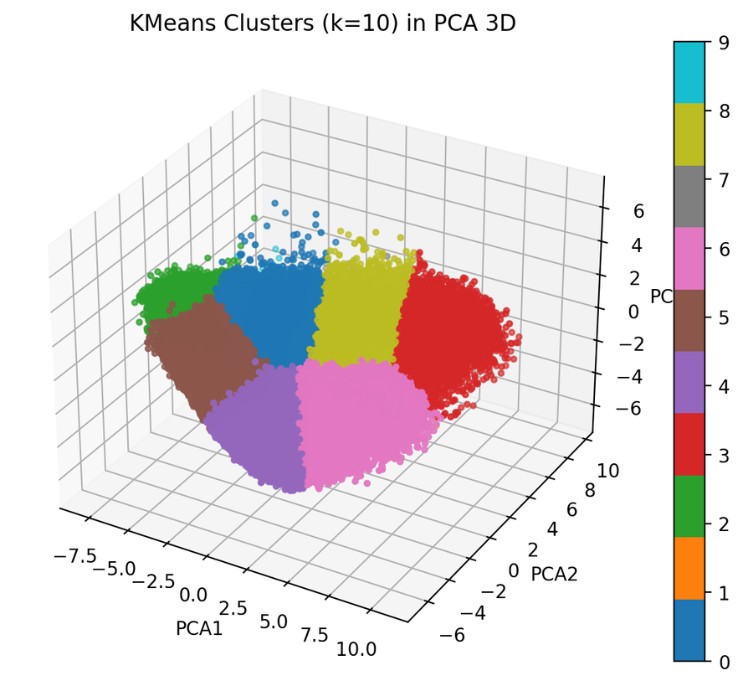
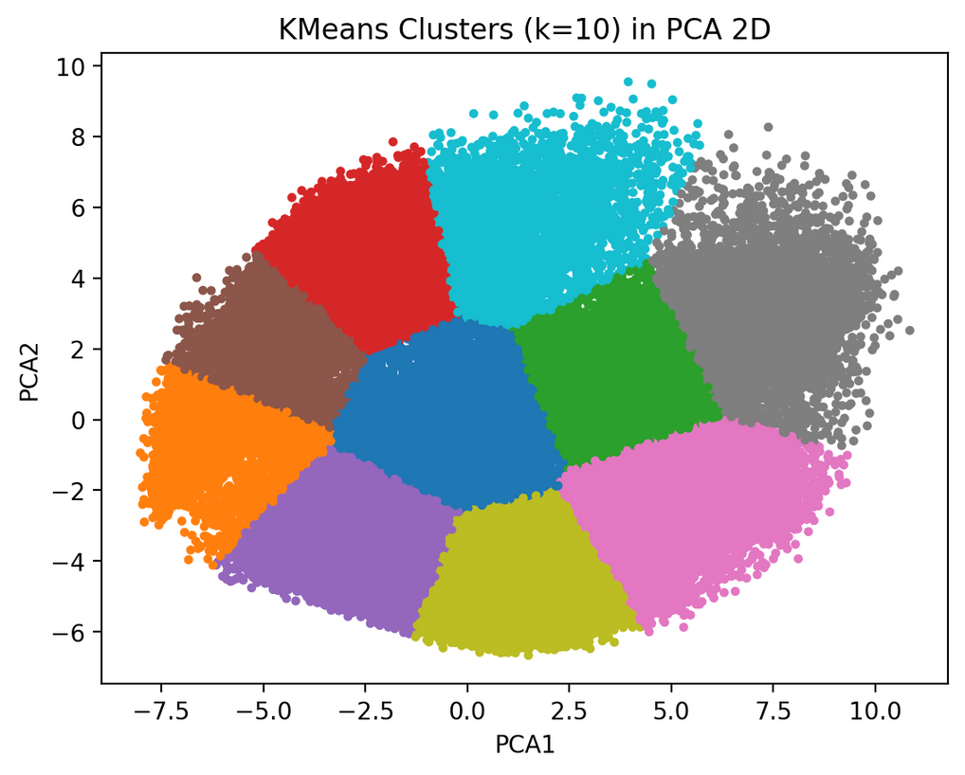
Visualization Highlights
PCA 2D/3D Clusters:

Slide 10
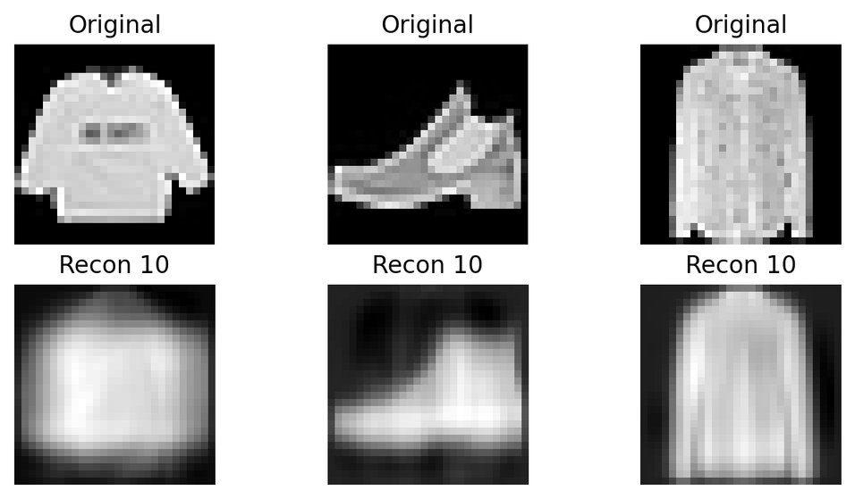
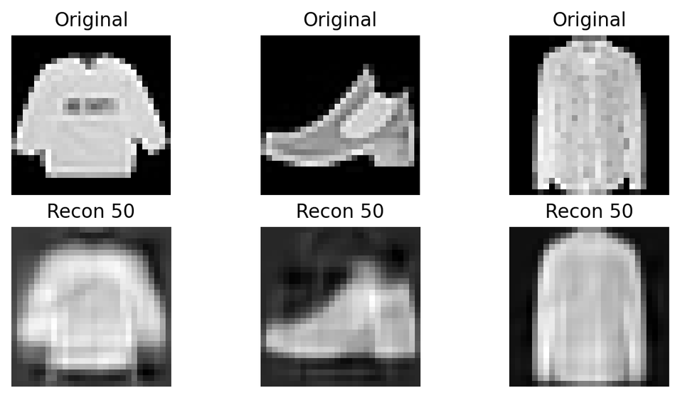
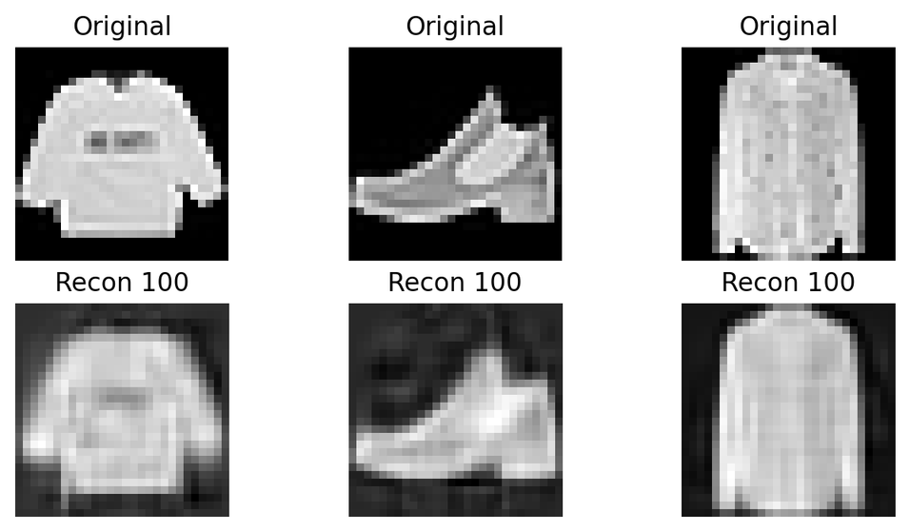
Reconstruction MSE:
10 Compenets
50 Compenets
100 Compenets

Slide 11
Conclusion
Summary:
10 natural clusters exist but with overlaps.
Confusion occurs in visually similar categories.
Auto-grouping is feasible for broad categories.

